Slide 1
Manufactured in Andover Lean Manufacturing & Effective Operations
Colm Watling
11/7/24

Slide 2
Why Listen to Me?
Teach Module 10 on Help to Grow (Management)
Military Logistics
Triumph Motorcycles – Lean
Manufacturing Advisory Service
Independent Consultancy

Slide 3
MODULE TEN
EFFICIENT OPERATIONS
Colm Watling
Cardiff Metropolitan University/Winchester/Bournemouth Etc
Business School Logo

Slide 4
Module 10 Learning Outcomes
By the end of the module you will:
Understand the role of operations within your business and how to take a systemic approach to aligning operations with marketing strategy
Be able to analyse the operations within your business using a value flow map
Have considered an approach to key measurements and continuous improvement that engages teams and creates a culture of continuous improvement in value flow
Recognise how your operations improvement strategy contributes towards your Growth Action Plan.
Notes:
Note to presenters/facilitators: Prep for Group Activity: To avoid delays while participants find files, please make a copy of the Workbooks available to your participants either by email just before the session, or as a file in the chat from the beginning of the session.
You may need to download the PDF from the VLE beforehand - and have it close-to-hand to share in this way (– or brief the cohort facilitator to do this on your behalf.)
Also helpful to add a link to the VLE resource here:
Duration (120 minutes):
Section 1: ~ 20 minutes
Section 2: ~ 40 minutes
Section 3: ~ 40 minutes
Brief walkthrough on workbook Task 3: ~ 10 minutes
Conclusion: ~ 10 minutes

Slide 5
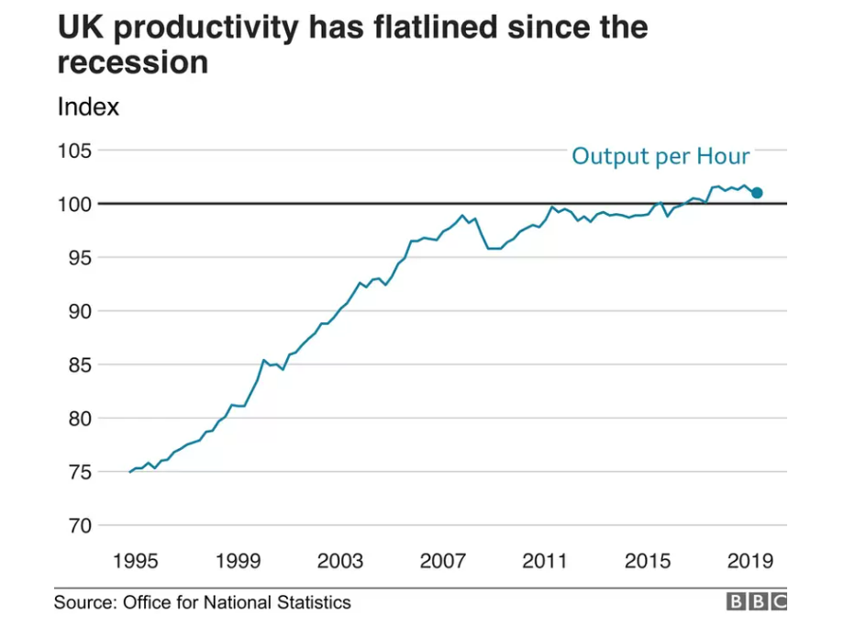

Slide 6
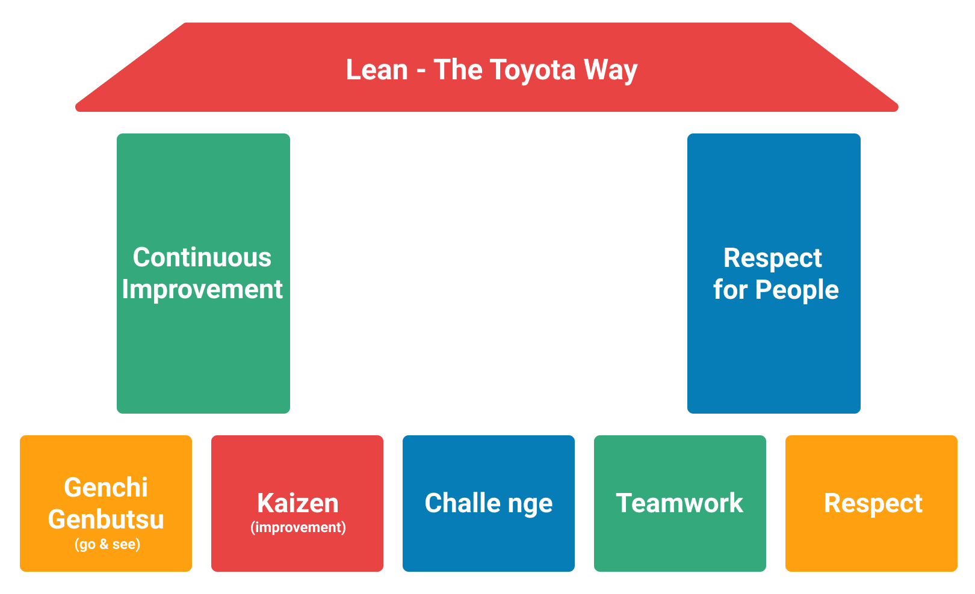

Slide 7
SECTION ONE
Operations in Perspective
Notes:
The first section of today's webinar will explore the systemic approach adopted to manage operations.
Workbook Task 1
Section 1, slides 5 – 15
Duration: ~20 minutes

Slide 8
Operations is a system of continuous improvement
Discussion: How does this relate to your business?
1. Inputs
2. Transformation Activities
3. Outputs
4.
5.
Feedback Loop
Although all Operations can be conceptualised as an input-output system, the nature of the five stages varies according to the value proposition of the company.
Notes:
The key function of Operations is to make the value proposition and improve the making process in multiple ways so as to remain comparatively superior.
When presenting this slide the importance of taking a systematic perspective should be emphasised.
Inputs include know-how, raw-materials, man-hours, components or parts, intellectual property, specialised skills etc, This can require developing a supportive ecosystem.
Transformation Activities include production process and support activities such as planning and control, receipt, storage and issue of materials, inspection, testing, quality, warehousing, etc.
Outputs include products, services and customer support.
The Feedback Loop provides data about the efficiency and effectiveness of Operations and drives improvement initiatives.
Further Reading
Gupta, Sushil, and Martin Kenneth Starr. Production and operations management systems. Vol. 1. Boca Raton: CRC Press, 2014.
Thomas, Ashish. "Developing an integrated quality network for lean operations systems." Business Process Management Journal (2018).

Slide 9
FOOD FOR THOUGHT Key operations questions for SME leaders…
How do your business operations contribute to the success of your business?
What is the current health (current state) of your operations: people, processes and technology?
What is the current / planned demand for your products and services? What capacity do you have?
Where do you need to improve?
Notes:
These are some questions which we will explore together with the participants. Q1: Section 1; Q2: Section 2; Q3 and Q4: Section 3.

Slide 10
Four Different Types of Operations Systems
If you offer standardised products or services then you are a Type 1 Business
If you are seeking to gain advantage from innovation then you are a Type 4 Business
If you offer professional products or services then you are a Type 2 Business
Types of Operations Management
If you design and deliver projects then you are a Type 3 Business
Notes:
This slide introduces the concept that Operations are not unitary. Rather they will be configured for different customer’s needs. When presenting this slide it is important to make the point that you will go into greater detail about each of these four types of Operations systems in the next hour.
Further Reading
Demeter, Krisztina, and Levente Szász. "Exploring operations of manufacturing plant types in international context." International operations networks. Springer, London, 2014. 29-50.
Mintzberg, Henry. The structure of organizations: A synthesis of the research. Prentice-Hall, 1979.
Burt, Ronald S., et al. "Contingent organization as a network theory: The culture-performance contingency function." Acta Sociologica 37.4 (1994): 345-370.
Lazić, Jelena, Janko M. Cvijanović, and Aleksandar V. Zeremski. "Some contingent determinants of organization structure." Industrija 37.1 (2009): 43-55.

Slide 11
Type 1 Operations Excellence in Practice
Inputs
Outputs
Companies with Type 1 Operations Excellence can say:
“We work closely with suppliers so that we get what we need on time.”
“Every stage in production has been studied so it is efficient.”
“We quickly detect problems and solve them effectively.”
“We are very cost-conscious and avoid unnecessary expense.”
“We improve continuously, adopting new ideas and technologies.”
“We often check that our operations are more effective than our rivals.”
Notes:
The presenter should spend a few minutes clarifying what it takes to be operationally excellent for this type. If possible, she or he can give a mini-case study of their choosing.
Discussion: How do you make ‘good’ happen?
Place this slide in the chat for use in the next Group Discussion.

Slide 12
Type 2 Operations Excellence in Practice
Expert Input
Competent Delivery
Service 1
Service 2
Services Design
Mentoring and Supervision
Service 3
Service 4
Technical Support
Companies with Type 2 Operations Excellence can say:
“We employ able, motivated and qualified experts.”
“We are very clear what services we offer.”
“Our specialists keep up with developments in their field.”
“Our technical support and infrastructure is state-of-the-art.”
“Everyone shares our vision, mission and values.”
“Those in senior positions act as mentors and role models.”
Notes:
The presenter should spend a few minutes clarifying what it takes to be operationally excellent for this type. If possible, she or he should give a mini-case study of their choosing.
Place this slide in the chat for use in the next Group Discussion.

Slide 13
Type 3 Operations Excellence in Practice
Client’s Needs
Situational Constraints
Co-Developed Solutions
Adaptive Execution
Delivery Company’s Capabilities
Companies with Type 3 Operations Excellence can say:
“We are specialists in using project planning techniques”
“We are effectively agile and adapt plans rapidly if needed”
“Real-time measurement ensures everyone tracks progress”
“Objectives and plans are fully co-developed with clients”
“We are socially and environmentally responsible”
“Expenses are continuously checked against budget”
Notes:
The presenter should spend a few minutes clarifying what it takes to be operationally excellent for this type. If possible, she or he should give a mini-case study of their choosing.
Place this slide in the chat for use in the Group Discussion.

Slide 14
Type 4 Operations Excellence in Practice
Searching
for needs and ideas
Exploring feasibility and potential advantages
Committing
to develop a new product / service
Realising
the intention by product development
Optimising
innovation through marketing and upgrades
Companies with Type 4 Operations Excellence can say:
“We have found a need for something new that we can provide.”
“We have strong research and development capabilities.”
“Sufficient funding for development costs is available.”
“We can protect the intellectual property in our innovation.”
“We use ‘lean-start-up’ thinking and work closely with users.”
“Our leaders support innovation through each of the five stages shown above.”
Notes:
The presenter should spend a few minutes clarifying what it takes to be operationally excellent for this type. If possible, she or he should give a mini-case study of their choosing.
Place this slide in the chat for use in the Group Discussion.

Slide 15
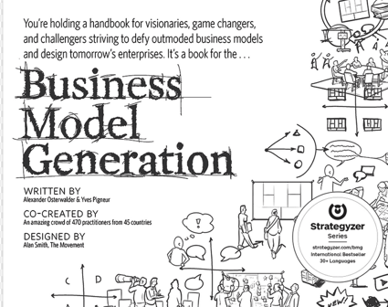
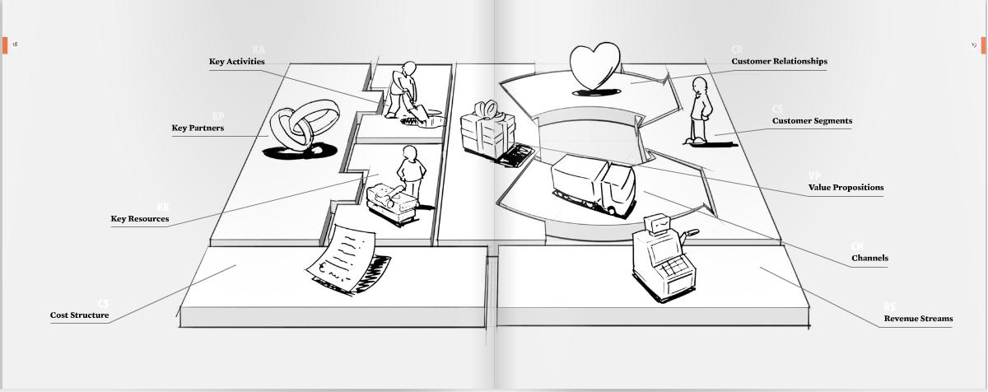
What is Operations Management?
Creating VALUE (in the form of products and services) and its Delivery (flow) to Customer by:
DESIGN products, services and experiences
DESIGN processes, layouts, facilities and supply networks to deliver products, services and experiences
MAKE / PRODUCE products and services
DELIVER products and services through our supply and customer networks
SUPPORT customers with their products and services
BUILD FINANCIAL AND ENVIRONMENTAL RESILIENCE BY:
Designing out waste, keep materials in use and regenerate natural systems (Circular economy principles) Ellen MacArthur Foundation Definition
Improvement in flow leads to improved productivity
Business Model Generation by Alexander Osterwalder
Notes:
A further illustration on the importance of operations in a business: to create value (left side of the BMC) and to deliver value (right side of the BMC)
Service = Operations management in a products, services and experiences perspective.

Slide 16
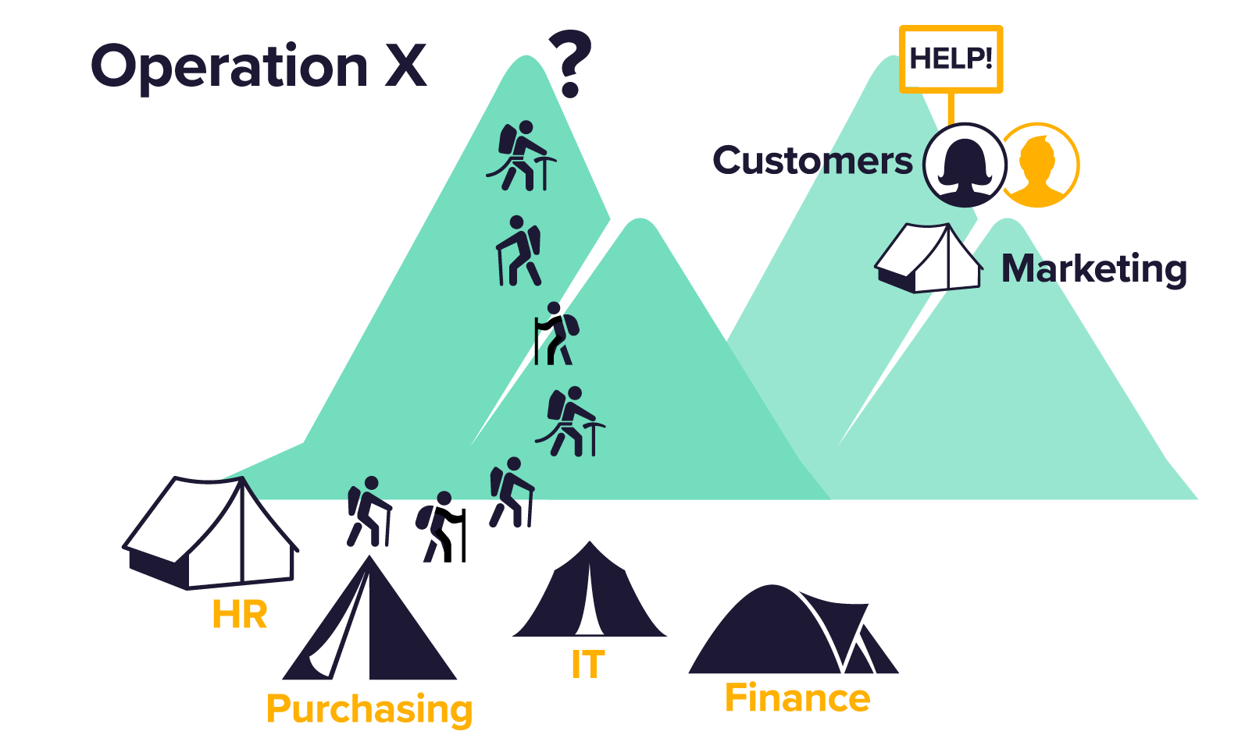
Operations in Perspective
The alignment of Operations processes with Marketing strategy. This ensures that we can deliver what we promise to our customers.
“If the ladder is not leaning against the right wall, every step we take just gets us to the wrong place faster” Stephen Covey
Image: Aquila Yeong

Slide 17
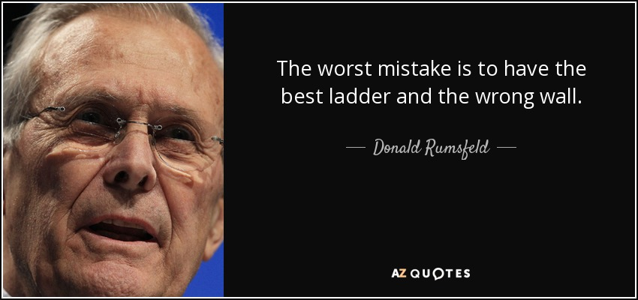

Slide 18
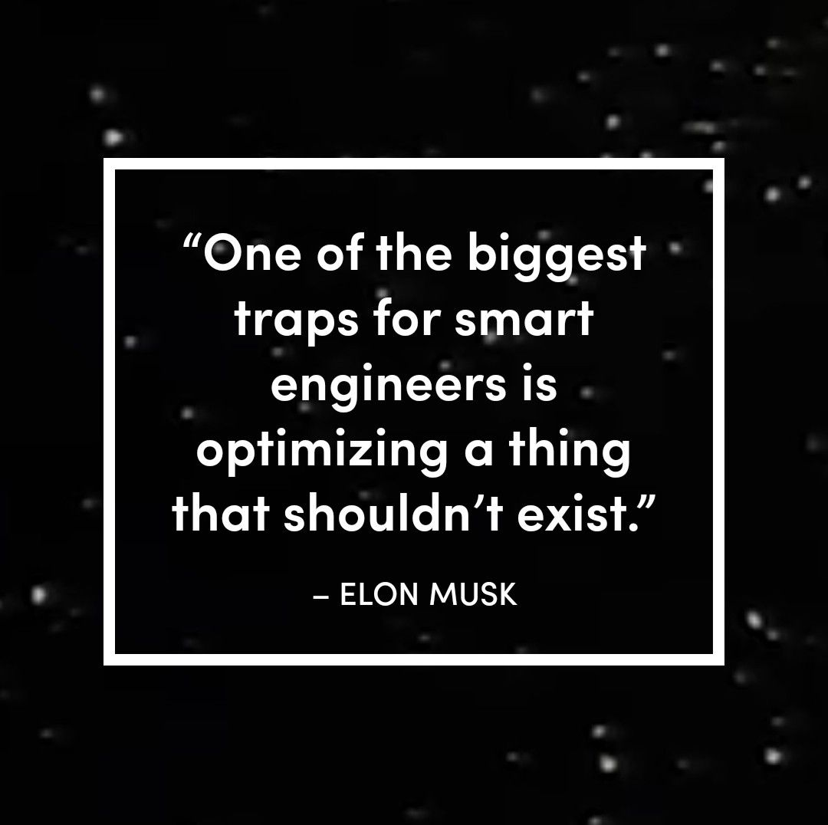

Slide 19
What does success look like?
Operations and Service:
QUALITY Doing things right… according to our spec AND customer expectations
SPEED Doing this fast… according to our sector
Competitive
Advantage?
DEPENDABILITY Doing things on-time… meeting our promises
FLEXIBILITY Ability to vary or adapt…
WHAT IS YOUR CARBON FOOTPRINT?
ENERGY USE?
WASTE GOING TO LANDFILL?
COST +
TRIPLE BOTTOM LINE – PEOPLE, PLANET, PROFIT (Elkington)
LEADING TO FINANCIAL, OPERATIONAL AND ENVIRONMENTAL SUSTAINABILITY
Adapted from Slack and Brandon-Jones, 2019
Notes:
The operating performance objectives should be aligned with delivering the order winner/order qualifiers identified
Refer to Energy Efficiency resource
DECC_advice_guide.pdf (publishing.service.gov.uk)

Slide 20
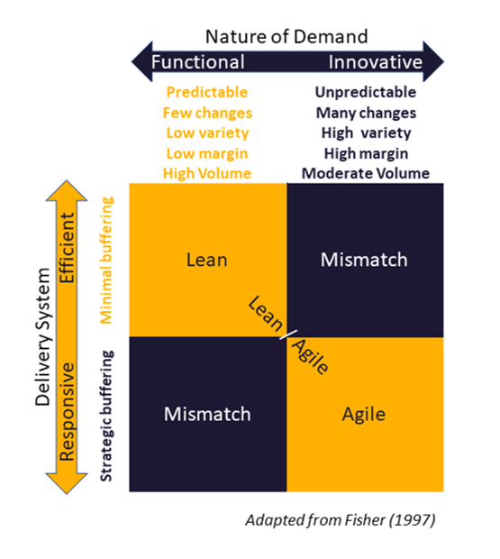
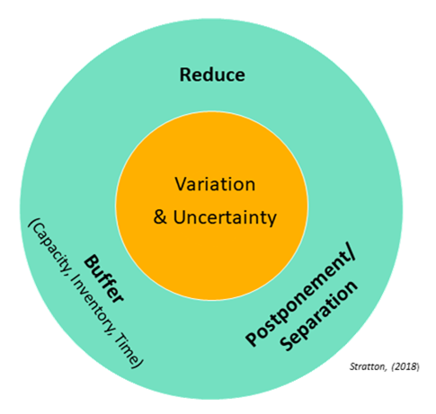
Is your value delivery system aligned?
A matching delivery system is achieved with the use of coordinated strategies: reduce, buffer, postponement/separation, to manage variation and uncertainty
Notes:
What does it mean to align the Value Delivery System (Operations Strategy) with the Nature of Demand (Marketing Strategy)?
Fisher’s model: highlights the spectrum of the nature of demand and delivery system design, together with their characteristics.
Nature of demand covers both service and product industries. You can relate this to the order winner criteria (OWC) and operating performance objectives and Value Proposition from the BMC
Highlight the variation and uncertainty associated with each ‘demand’. Remember Module 7 and the need for adaptive planning when it is hard to predict the nature of demand or the direction of a project.
Stress the importance of matching the delivery system with the nature of the demand.
Briefly discuss how the coordinated strategies of ‘Reduce’, ‘Buffer’, and ‘Postponement/Separation’ are deployed to manage variation and uncertainty in the three different delivery systems: Lean, Agile, and ‘Leagile’.
For example: reduce uncertainty by refining the number of colour options available to customers;
- buffer against uncertainty by holding a strategic inventory of components that can be assembled to order and creating a time buffer while the customer waits for their bespoke, assembled item;
- or postpone and separate the point at which variation takes place by offering an element of customisation, but only in the final stages of delivering a product or service, such as printing a name on a football shirt at the point of sale.
More details/discussion point can be covered according to the need of each cohort (Be Agile)

Slide 21
PROCESS MAPPING: Value Stream Mapping and Service Blueprinting
Notes:
Through this section and the activity that follows, participants will gain hands on experience in using the above tools and apply this in their business. The following slides show examples of process mapping techniques and slide 28 is a group activity in making and selling a hot drink using the process mapping tools. What contributed to the desired or undesired effects identified in earlier activities?
Slides 21 – 28 will introduce process mapping as a visualisation tool to assist participants to evaluate their operations.
Slide 22 – 27 are examples: Basic flow charts, Swim lane, Service blueprinting, SIPOC, Input-Output.
A separate workbook (workbook 2 – Process Mapping) has been provided to complete their own process mapping before the peer group call.
Participants could adopt the one which they find most relevant. The exercise can be done on paper, or in a spreadsheet, but if you wish to advise participants to use a digital tool, pre-formatted templates are available on Miro (Miro template library).
(Workbook 1 – Task 1.6)
There are four videos provided on the VLE and a link in the workbook to provide further guidance.
https://researchportal.port.ac.uk/portal/en/publications/value-stream-mapping-in-a-service-environment-a-comparison-of-approaches(dcb15df8-be16-49ca-b512-d5a0cb009dd4).html

Slide 22
An example: basic flow chart
Amberol, a planters and bins manufacturer, adopts a Make-To-Order approach, where products will only be put into production after order confirmation.
The manufacturing process is as shown below:
Source: Aquila Yeong, NBS
www.Amberol.co.uk
Notes:
Amberol is an SME manufacturer of heavy duty plastics, that incorporates Amberol’s unique self-watering AquafeedTM technology. Products include the planters and bins used in public spaces and as street furniture.
Orders are therefore based on B2B bulk orders for standard or customised products (eg according to the colours and branding of a specific Local Authority or Commercial space). Self-watering planters, hanging baskets, window boxes & more! (amberol.co.uk)
Facilitator note: could use alternative local case study

Slide 23
An example: basic flow chart (customer’s perspective)
For businesses with service elements, a value flow map could be drawn by adopting the customer’s perspective or customer’s journey
Source: Aquila Yeong, NBS
Notes:
Adding the customer’s perspective to the value flow map adds an additional dimension.
This is very important for service-based businesses, where the customer is intrinsically involved at various stages by ‘receiving’ the service, such as having their hair styled, or approving design ideas for their branding.
For Amberol, this service might include custom design or training local estates staff in use and care of the product.
Facilitator note: could use alternative local case study

Slide 24
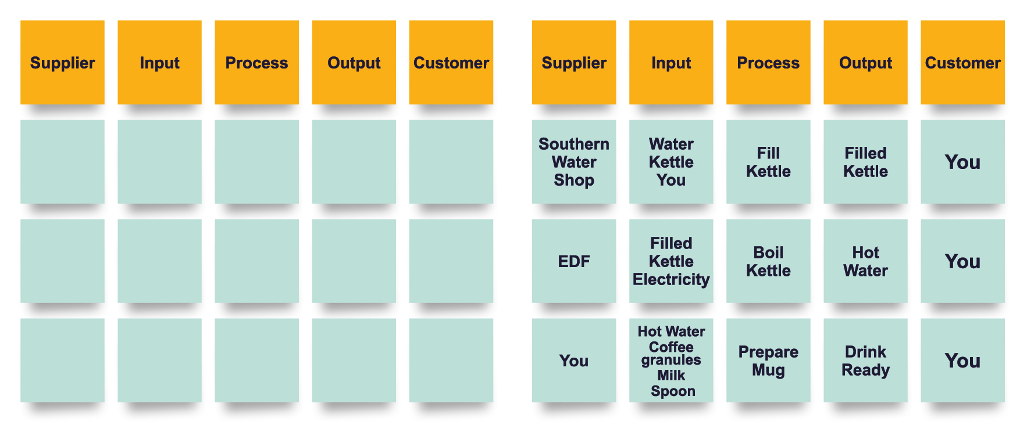
An Example: SIPOC
Refer to Video available on VLE for further guidance: Mod10 Process Mapping 3 – SIPOC
Source: Tammi Sinha – SU
Notes:
Refer to Video available on VLE for further guidance: Mod10 Process Mapping 3 – SIPOC
A SIPOC diagram is a planning tool that defines a complex project – for example at the Measure phase of the Six Sigma DMAIC process.
SIPOC summarises: Suppliers, Inputs, Process, Outputs and the Customers that receive the process outputs.
It is particularly helpful to determine and help everyone to consider the following :
Who supplies Inputs to the process?
What specifications are placed on the Inputs?
Who are the true Customers of the process?
What are the Requirements of the customers?

Slide 25
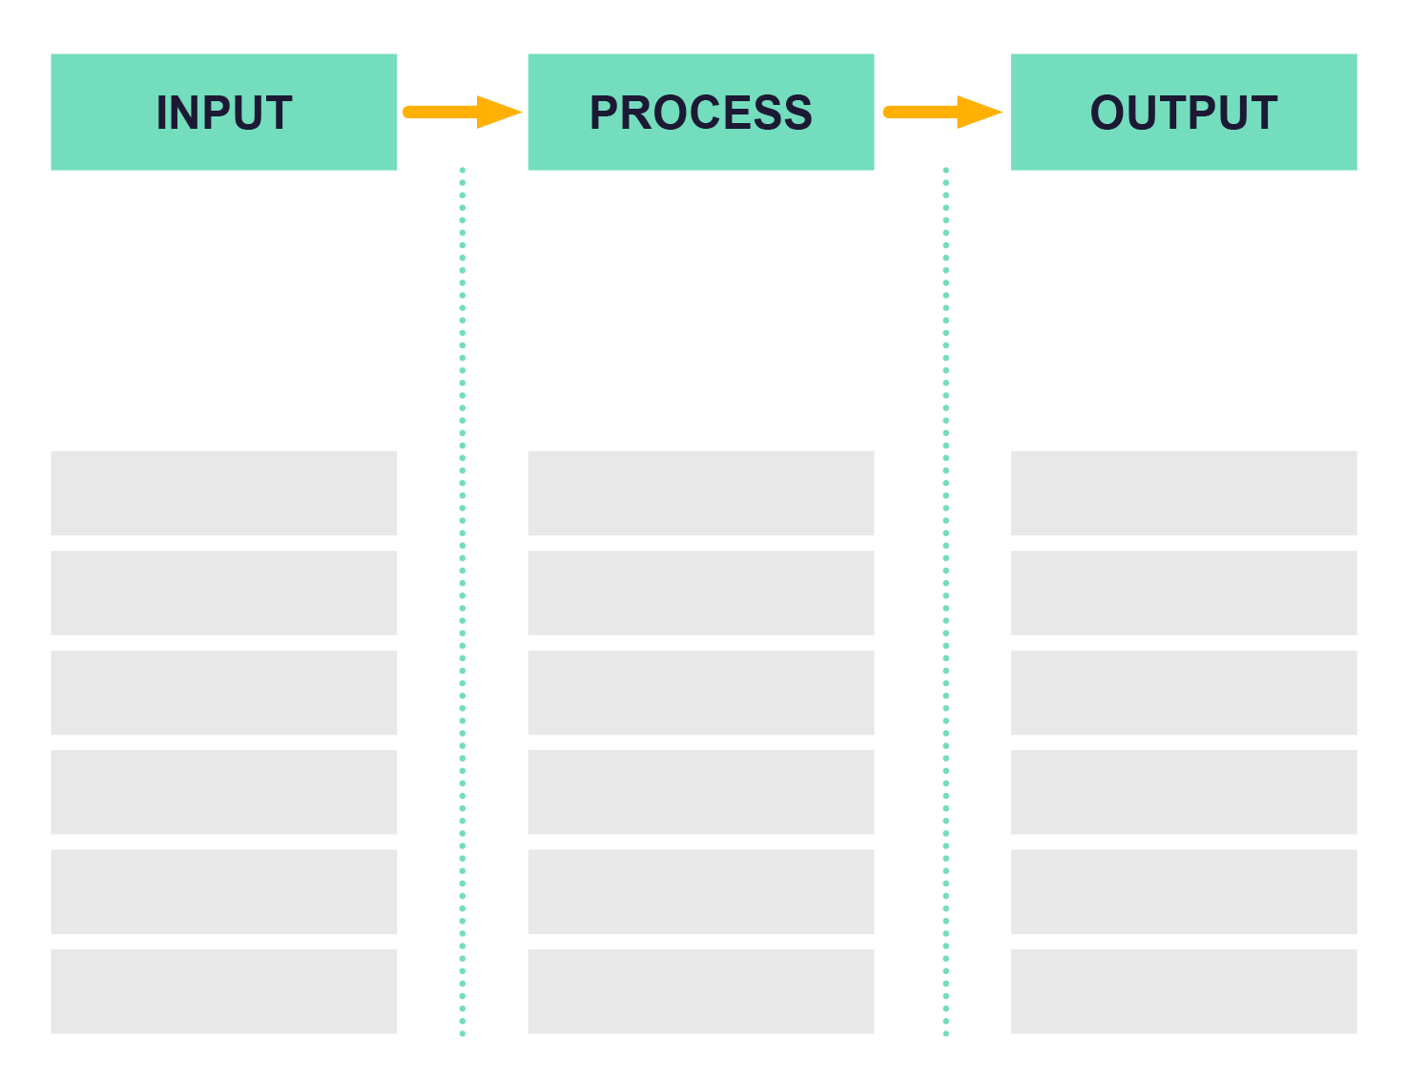
An Example: IPO (Input/Output)
Get orders?
Fulfil orders?
Develop products, services and processes?
Support products, services and processes?
What inputs, activities and outputs do you have?
How do you manage the flow, materials and teams?
Where are the pain and joy points in your process?
Where is the ‘waste’ (i.e. activity that does not add value)?
Refer to Video available on VLE for further guidance: Mod10 Process Mapping 4 – Input-Output Transformation
Source: Tammi Sinha – SU
Notes:
Refer to Video available on VLE for further guidance: Mod10 Process Mapping 4 – Input-Output Transformation
Facilitator note: could use a local case study to support

Slide 26
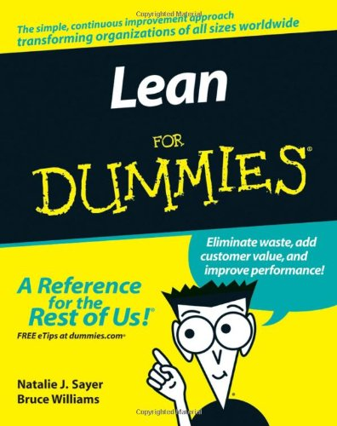

Slide 27
SECTION THREE
CONTINUOUS IMPROVEMENT
Notes:
The final part of the session will highlight the importance of engaging all employees in this work and offers some practical tools to help build a culture of continuous improvement
Section 3: Continuous Improvement: Slides 31 – 42
Duration:
Concept (including group activity 1): 25 minutes
Group activity 2: 15 minutes

Slide 28
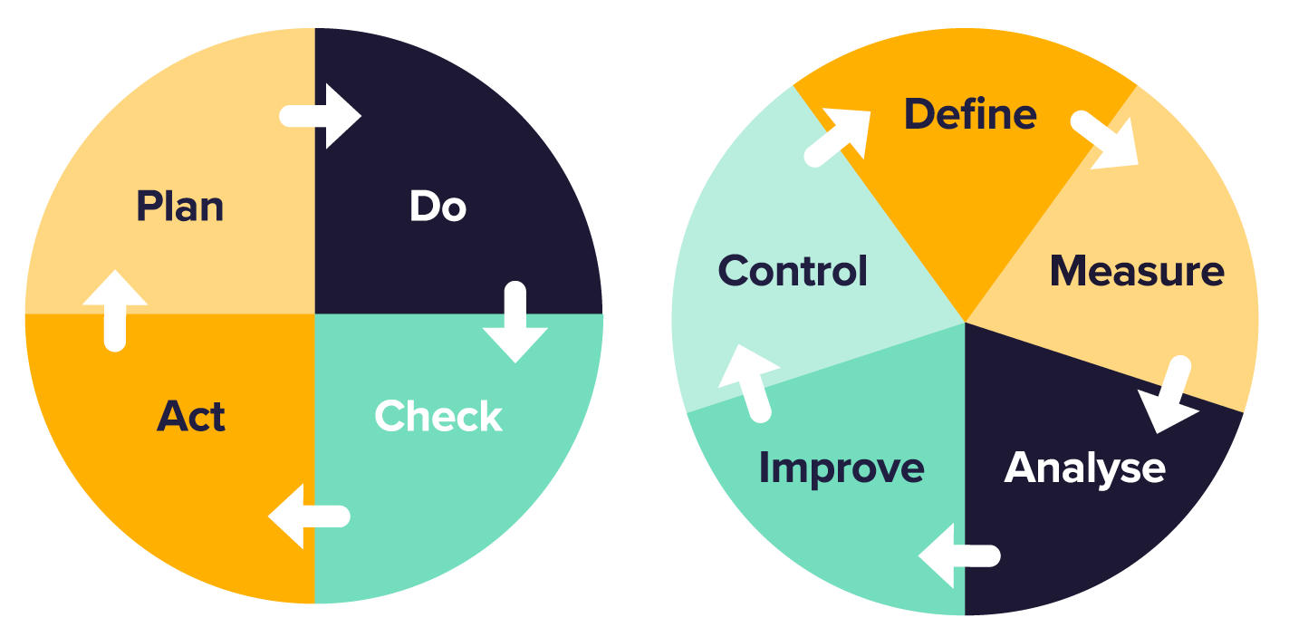
Continuous Improvement…
Best practices such as Circular Economy, Total Quality Management (TQM), Lean, Six Sigma, Theory of Constraints (TOC) stress the culture of continuous improvement.
5 Lean Principles
5 Focusing Steps
Slack and Brandon-Jones (2019)
Notes:
What is continuous improvement?
Some of the best practices which are available to use to continuously improve your business.
5 Lean Principles:
Specify value
Map the flow of value
Make value flow
Pull from the customer
Seek perfection
5 Focusing Steps (Theory of Constraints)
Identify the system’s constraint(s) – factors that stop the operation performing well
Decide how to exploit the system’s constraint(s) – make sure that the limiting step is fully used
Subordinate everything else to the above decision – prioritise step 2 and align everything else to this
Elevate the system’s constraint – increase the productivity at the weakest point in the process by removing unnecessary tasks, increasing capacity, hiring new staff, etc.
If in the previous steps a constraint has been broken, go back to step one to find the next constraint. Don’t allow inertia to cause a system’s constraints

Slide 29
Reflect on your existing Continuous Improvement practices
What triggered you/your organisation to put in place continuous improvement practices? (Any particular issue?)
What measurements/reward/policies are in place to support this? (These could relate to Operating Performance Objectives)
What made this a success/failure?
What are your thoughts on the following?
Notes:
Split the group into Breakout Rooms or individually as appropriate. At the end of the breakout/group activity, ask a few volunteers to share their group findings/thoughts with the whole group.
The three quotes by Deming could open up further conversation on the relationship between People, Performance Measurement (or policies/reward schemes), and Continuous Improvement
This will be further explored in Slides 36 and 37.
If performance evaluation supports/encourages short term performance, (according to Deming) how can you encourage people to work towards continuous improvements?

Slide 30
People and Measurement…
One of the 7 deadly diseases highlighted by Deming is “Evaluation of performance, merit rating, or annual review”
“It nourishes short-term performance, annihilates long-term planning, builds fear, demolishes team-work, nourishes rivalry and politics”.
“Merit rating rewards people that do well in the system. It does not reward attempts to improve the system. Don’t rock the boat”.
“Tell me how you measure me, and I’ll tell you how I’ll behave” (Goldratt, 1990)
Measurement distorts human behaviour…
Notes:
Have a few volunteers to share their thoughts/experience
The policies put in place should encourage system improvement rather than to penalise.
It is also necessary to be aware of local optima versus system performance.
Using Chain Analogy, the strength of the chain depends on the weakest link. If local optima is adopted, the weakest link will be further penalised, and the strongest links will be further rewarded, yet this contributes nothing towards improving the system performance as a whole.
This could lead to the discussion on ‘Where’ should the improvement be? Given limited amount of financial resources, where should investment be made? To further reward and invest on departments which is overperforming, or to focus on the constraint in the system, which is the ‘weakest link’?
This could also be linked to cost accounting vs throughput accounting (Module 11). Should each department perform according to their capacity or should they perform according to the throughput of the system?
Further details: https://www.tocico.org/page/toc_portal

Slide 31
To measure or Not to measure…?
Leadership, teamwork for continuous improvement
“It would be better if everyone worked together as a system, with the aim for everybody to win.” (Deming)
“We must preserve the power of intrinsic motivation, dignity, cooperation, curiosity, joy in learning, that people are born with.” (Deming)
To explore further:
Watch The Red Bead Experiment
Read Chapter 3 of “Out of the Crisis” by Deming
Notes:
Highlight that People are at the centre of developing a culture of Continuous Improvement.
Deming’s Red Bead Experiment demonstrates how employees can be easily blamed for a ‘system problem’ which they do not have control of? You won't have time to play the video, but anyone interested can come back to it.
Get participants to relate this to Module 8, Employee Engagement and Leading Change (slide 35). How do these relate to their own business?

Slide 32
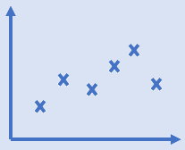
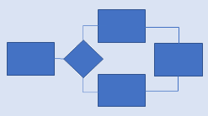
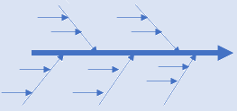
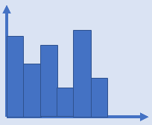
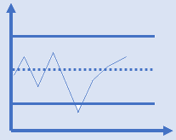
Some practical tools to analyse current state…
Cause-effect Diagram
Check Sheet
Scatter Diagrams
Flow Chart
‘5 Whys’ Analysis
Pareto Diagrams
Control Chart
Why?
Why?
Why?
Why?
Why?
Ishikawa (1985), drawn by Yeong
Notes:
Some tools to help employee engagement in continuous improvement, based on understanding where you are now ‘current state’ and the common complaints or compliments as discussed earlier.
The following slides illustrate these tools in practice.

Slide 33
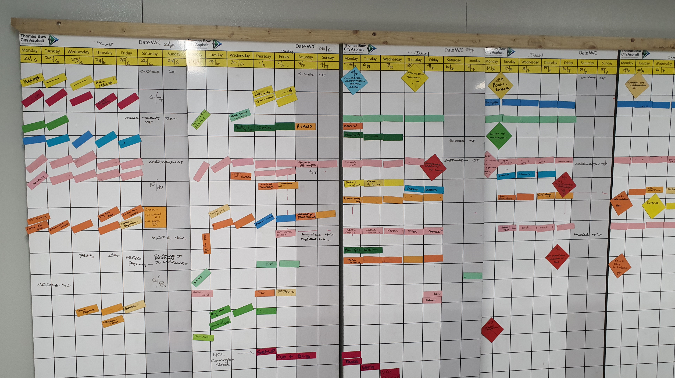
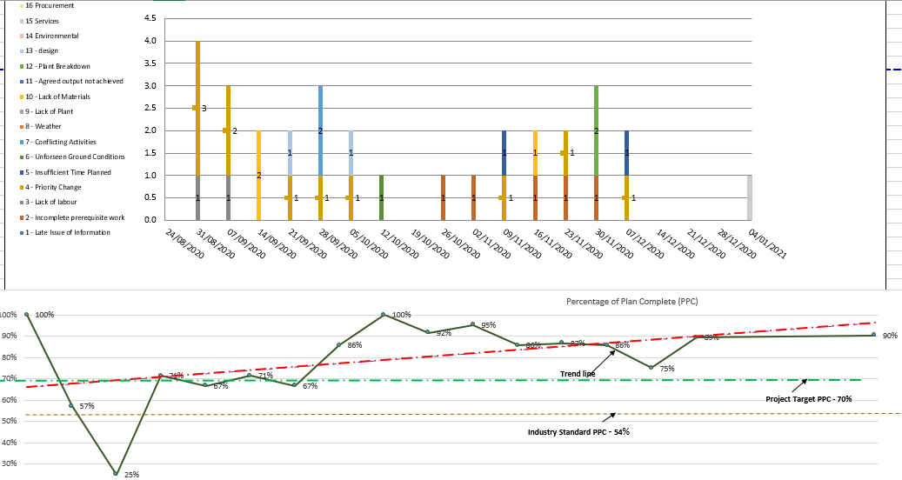
An example:
Continuous Improvement practice in Thomas Bow, a civil engineering company
Control Chart
Scatter Diagrams
Pareto Diagrams
Flow Chart
Thomas Bow
Notes:
An example on how these tools are used for Thomas Bow in a project environment. It is a combination of a physical 'last planner board' and digital Critical Chain Project Management (CCPM) platform.
Link back to module 2 Digital Adoption and tools available

Slide 34
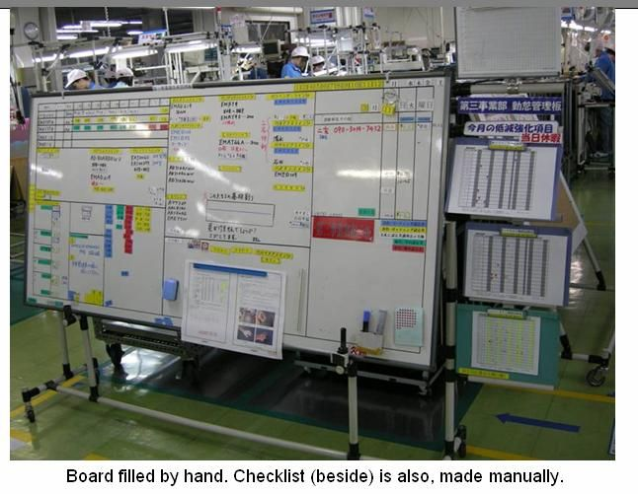
https://www.visit-bmwgroup.com/en/experience/plant-oxford-tour/
https://www.toyotauk.com/lean-approach/
https://experience.landrover.co.uk/corporate/lean-experience-days.html

Slide 35
Example 1:
Criminal Justice System: problem statement – “too many cases are adjourned leading to delays in completing cases”
Witnesses (as customer)
Process
Too many court
adjournments
Better information to
-
Effect
witnesses at an earlier stage
Time taken
-
Lack of contact with
Earlier involvement
to prepare case
Too long between
Pre-hearing and trial
witnesses and notification
of witness service
(ng plea)
of trial dates
Identification of
Too long between
Clogging up court
vulnerable or
initial charge and
lists by ineffective
Lack of involvement
intimidated witnesses
PTR
hearings
Delays in
Completing
cases
of witness service at
early stage
Unclear roles and responsibilities
Files incomplete
Poor perception
Too many pre-hearings
of pre-hearings
Systems not integrated
between
agencies
Statement
procedures not
followed
Defence lack
engagement
Lack of sanctions
or benefits
Target
Timescales not
achieved
-
Public lack
confidence
Lack of awareness
Data not used
for case management
at pre
-
-trial
People perception/attitudes
Methods/
procedures
Technology
Cause
Source: Dyason M., Kaye M.
Notes:
Emphasise the importance of addressing the “burning issue”, i.e. the action that will have the greatest impact on customer value. This is the “problem statement” and should be agreed with your teams. Work with teams (all functions and levels) to identify the causes of the problem.
This tool can be used with other partners in the supply chain – ask for their views. In this example the Crown Prosecution Service, Solicitors and Police were involved in identifying the cause of the problem.
Link back to module 2 – Digital Adoption
Digital tools can help to identify where the problems are occurring, by analysing data to identify patterns or capturing customer feedback via reviews or surveys.
Digitisation can also help to resolve the problems, using systems to improve the data flow, create visibility and overcome errors and bottlenecks.
Facilitator note: could use alternative local case study

Slide 36
Example 2:
Computer hardware manufacturer: problem statement: “too many rejected products at the end of the line”
Customer
Financial
Fierce
Competition
Lack of loyalty
Finished product
reject high
Perception and
expectations
not understood
Too much
stock held
(inventory
Management)
Effect
Reputation
damaged
Inbound material
quality poor (waste)
Changing
specifications
Too many
product rejects
Suppliers’ poor
quality standards
Poor
maintenance
Machine
failure
Duplication
of processes
Lack of
quality
improvement
culture
Production lead
times slow
Production lines/skill sets inflexible
Technology
outdated
Redundant
Steps (re-work)
IT/digital systems
not aligned with
process flow
Lack of team
working
Human
Resources
Machines
Process/
Methods
Cause
Source: Dyason M., Kaye M.
Notes:
In this example the production team and suppliers were involved in identifying the root cause of the problems. The causes of the problem were grouped into these headings. It emphasizes the need for engagement with all people involved in the process.
The supplier quality was found to be a big issue and this activity gained their understanding and commitment to change.
Facilitator note: could use alternative local case study

Slide 37
Step 1: Issue Identification
This could be:
The most ‘burning’ issue
What is the most undesired effect (from complaint list, how to reduce/eliminate it?)
What is the most desired effect (from compliment list, how to have more of it?)

Slide 38
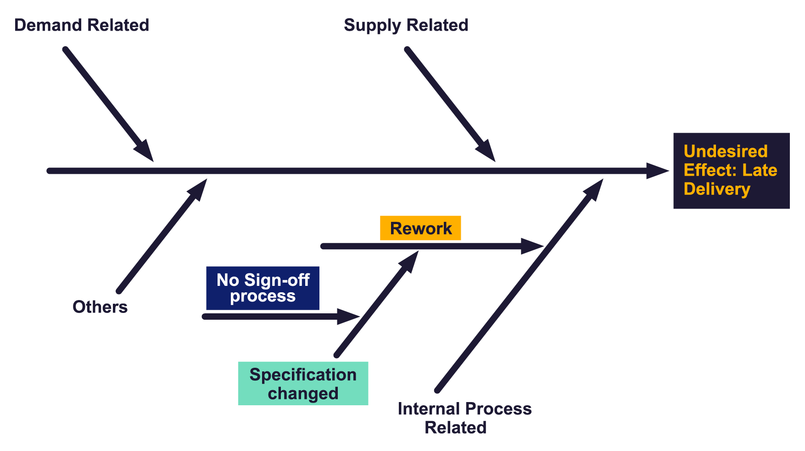
Step 2: Conduct Cause-Effect Analysis
Engage your team members to brainstorm…
Any common root cause?
Any correlation between root causes?
Any main ‘constraint’ or ‘bottleneck’ in the flow of value

Slide 39
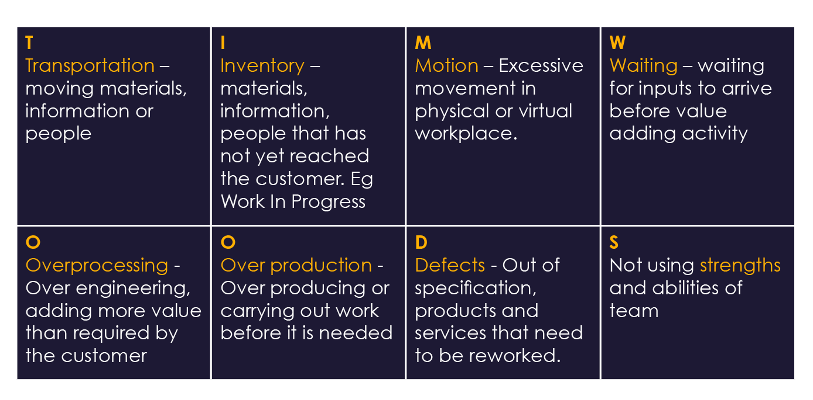
Step 3: Identify Waste - TIMWOODS
Source: Ohno, T., & Bodek, N. (2019).

Slide 40
Step 4: Look out for potential issues
The following practices cause non value-added processes (Smith, 2010) and could be eliminated
Authority ambiguity: When two or more people are providing approval
Role ambiguity: Lack of clarity about the expectations, norms, and behaviours of a particular job and related relationships and reporting
Bottlenecks: When several information flows lead to a single activity that has inflexible capacity downstream.
Data duplication: Occurs when multiple groups involved in the process each maintain their own separate information systems.
Handoffs: Involve the transfer of responsibility from one role to another, providing the opportunity for mistakes, miscommunication, and delay.
Notes:
Issues that cause non-value-added processes
Role ambiguity: Denotes lack of clarity about the expectations, norms, and behaviours associated with a particular job. Transactions affecting those assets; (3) recording or reporting of related transactions.
Bottlenecks: When a number of information flows lead to a single activity, the process may be hindered by insufficient resources dedicated to the roles and events
Data duplication: Occurs when multiple groups involved in the process begin maintaining their own separate information systems.
Handoffs: Involve the transfer of responsibility from one role to another, providing the opportunity for mistakes, miscommunication, and delay.

Slide 41
Look out for potential issues (cont...)
Manual steps: Manual steps, which are labour-intensive and add to cycle time and errors, are retained - even thought they could be digitised
Old ways: Technology and systems are available but not used because of lack of training or resistance to adoption. Employees revert to ‘‘old ways of doing things.’’
Cycle time: The duration of the entire process flow should be at the heart of performance measurement, prioritising the length of time it takes from start to finish.
Quality control: Quality control is when someone else checks work, not when someone checks his/her own work.
Paper records: Is the current process adding, maintaining, or eliminating paper records?
Rework: People spending time fixing errors or remediating problems.
Notes:
Manual steps: Technology and systems could be implemented to take the place of manual steps, which are labour-intensive and add to cycle time and errors.
Old ways: Technology and systems are available but not used because employees have not been trained (or have been trained and do not want to use them). Employees revert to ‘‘old ways of doing things.’’
Cycle time: The time consumed during the entire process flow should be at the heart of performance measurement, providing focus on the length of time it takes from start to finish.
Quality control: Quality control is when someone else checks work, not when someone checks his/her own work.
Paper records: Question whether the current process is adding, maintaining, or eliminating paper records.
Rework: People spending time fixing errors or remediating problems.

Slide 42
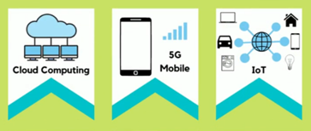
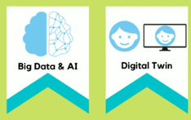
Workbook 1 Activity 3
Industry 4.0 Technologies
In the future the Change Drivers discussed in Module 2 may have significantly changed your Operations Management.
Workbook Activity 3 is to discuss Future Operations Management and Change Drivers with colleagues in your business after the webinar
Source: sustainability-success.com – 10 Digital Transformation Technologies
TOP 10 Digital Transformation Technologies for 2022 - YouTube
Notes:
FIRST DISCUSSED IN MODULE 2
Invite participants to reflect on how these technologies will affect their operations in the future as we move through the next few slides.

Slide 43
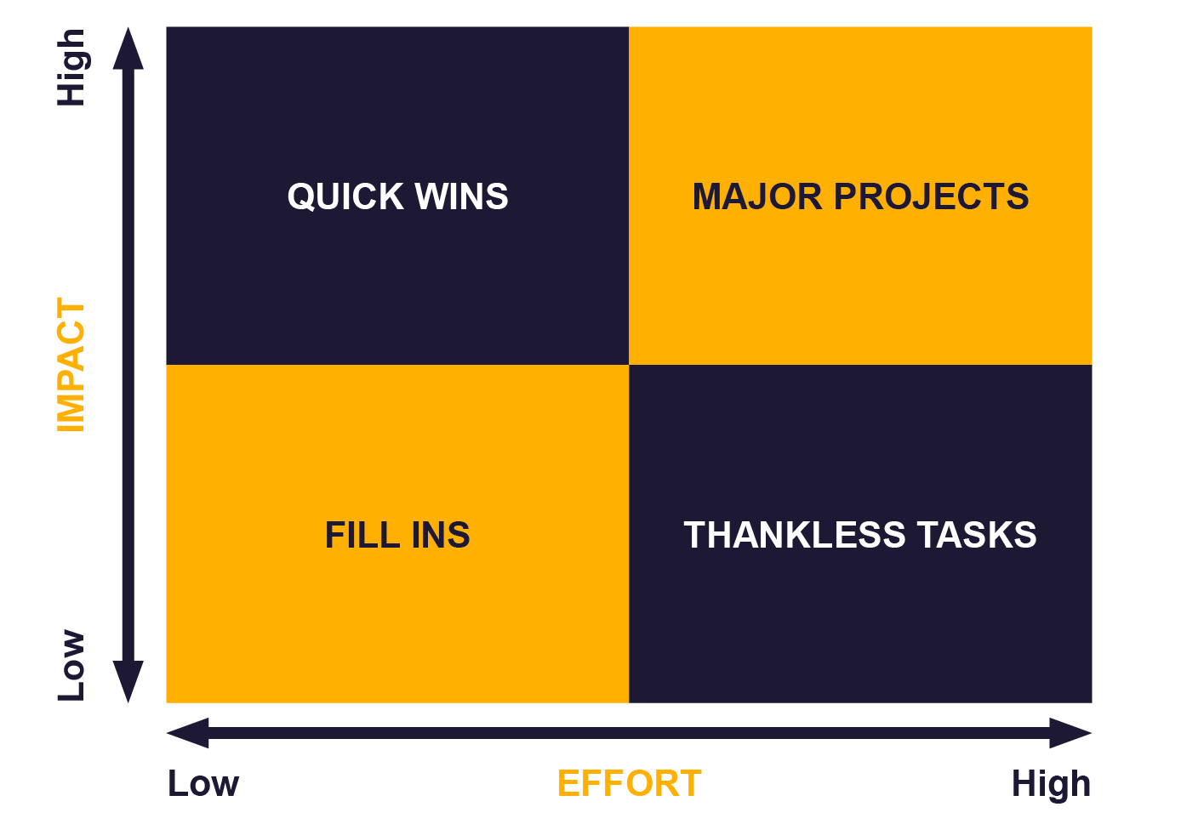
Prioritise
Prioritise your ‘to do’ improvements using the Action Priority matrix
https://www.lucidchart.com/blog/priority-matrix-project-management
Notes:
This slide corresponds to Workbook 2 – Question 5.
There might be many different ‘actions’ needed to be undertaken. These may well need to be rationalised!
This matrix might help participants to prioritise the actions and feed them into the Growth Action Plan.

